Slide 1
Teacher notes

Slide 2
Topic: Right-angled triangles
EQ: Using trigonometry in real life scenarios

Slide 3
Definitions
Angle of Elevation - is the angle between the horizontal and the line of sight to an object above the horizontal.
Angle of Depression - is the angle between the horizontal and the line of sight to an object beneath the horizontal.

Slide 4
Vocabulary
Angle of Depression and Angle of Elevation are Equal
Horizontal Line
Angle of Depression
Angle of Elevation
Horizontal Line

Slide 5
Identifying Angles of Elevation and Depression

Slide 6
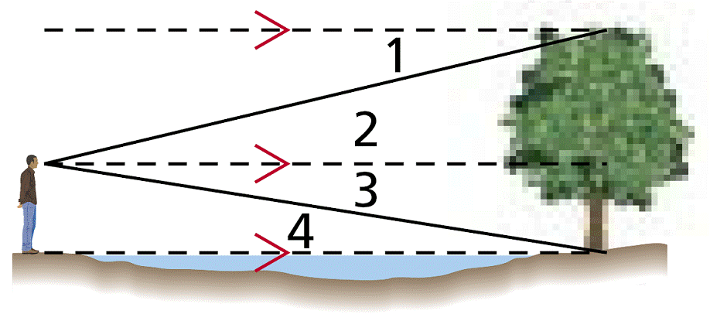
Example 1: Classifying Angles of Elevation and Depression
Classify each angle as an angle of elevation or an angle of depression.
∠1
∠1 is formed by a horizontal line and a line of sight to a point below the line. It is an angle of depression.

Slide 7
Example 2: Classifying Angles of Elevation and Depression
Classify each angle as an angle of elevation or an angle of depression.
∠4
∠4 is formed by a horizontal line and a line of sight to a point above the line. It is an angle of elevation.

Slide 8
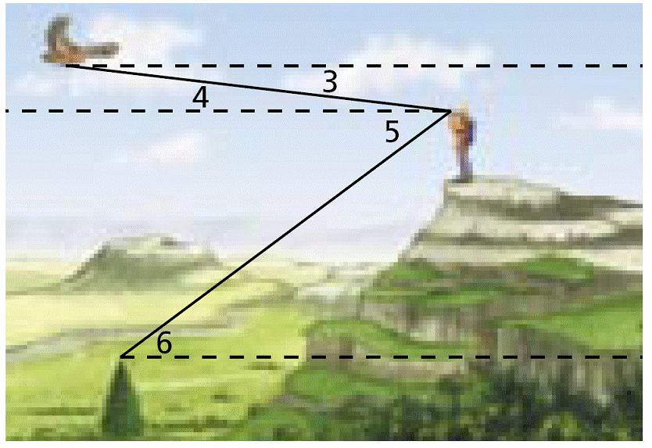
Check It Out! Example 3
Use the diagram above to classify each angle as an angle of elevation or angle of depression.
3a. ∠5
∠5 is formed by a horizontal line and a line of sight to a point below the line. It is an angle of depression.
3b. ∠6
∠6 is formed by a horizontal line and a line of sight to a point above the line. It is an angle of elevation.

Slide 9

A Line of Sight Example
You sight a rock climber on a cliff at a 32º angle of elevation. The horizontal ground distance to the cliff is 305 m. Find the line of sight distance to the rock climber.
x
305 m

Slide 10
An Airplane Example
An airplane pilots sights a life raft at a 26º angle of depression. The airplane’s altitude is 3 km. What is the airplane’s surface distance d from the raft?
3 km
d

Slide 11

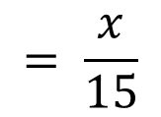
An Example
A surveyor is standing 15 m from the base of a large tree. The surveyor measures the angle of elevation to the top of the tree as 71.5°. How tall is the tree?
tan 71.5°
$$= \frac{x}{15}$$
?
y = 15 (tan 71.5°)
71.5°
$$y≈44.8 m$$
15 m

Slide 12
Angle of Elevation and Depression
Suppose the angle of depression from a lighthouse to a sailboat is 5.7º. If the lighthouse is 150 ft tall, how far away is the sailboat?
5.7º
150 ft.
5.7º
x
Construct a triangle and label the known parts. Use a variable for the unknown value.

Slide 13
Angle of Elevation and Depression
Suppose the angle of depression from a lighthouse to a sailboat is 5.7º. If the lighthouse is 150 ft tall, how far away is the sailboat?
5.7º
150 ft.
5.7º
x
Set up an equation and solve.

Slide 14
Angle of Elevation and Depression
150 ft.
5.7º
x
x is approximately 1,503 ft.

